Slide 1
VLSI and Embedded (E&C) Presentation on “ENHANCEMENT OF NIGHT TIME VIDEO IP ACCELERATOR USING DCP”
Presented By:
Rakotojaona Andrianoelisoa Nambinina,PATEL Monal
, Electronics and Communication
Supervised by:
Prof. Carlos Valderrama (External Guide)
Head of Microelectronics Department,
University of Mons, Belgium
Notes:
1
semi1009

Slide 2
Outline
Introduction
DCP Algorithm
Vitis unified software
Required Component
Programming languages
Library used for hardware implementation
software/hardware implementation of algorithm
Result
Conclusion
references

Slide 3
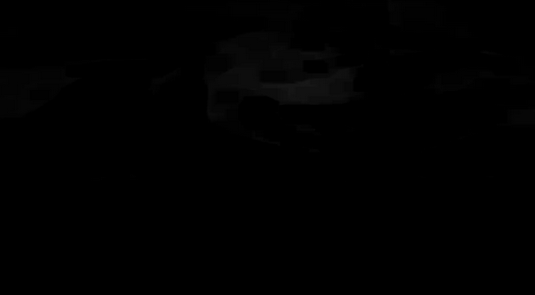
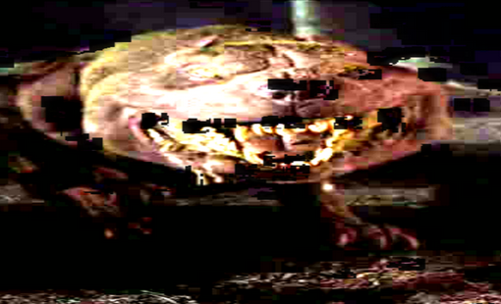
Introduction
Aim:-
Enhanced night input frame
Accelerate the video processing speed
Input frame Enhanced frame
Enhancement
Notes:
Enhancement

Slide 4
Introduction
Hardware available for implementation
Criteria | CPUs | GPUs | FPGAs | ASICs
Processing peak power | Moderate | Very High | High | Highest
Power Consumption | High | Very High | Low | Very Low
Flexibility | Highest | Very High | Medium | Lowest
Parallelism design
Consume less power
Reconfigurable hardware

Slide 5
DCP Algorithm
Enhancement: Computer system modeled to enhanced the quality of input frame
DCP algorithm: enhanced night input frame based on the minimum pixel value of RGB
WHY DCP
Simple algorithm
Less component on hardware
Fast

Slide 6
DCP Overview
Model mathematical of McCartney
I (x) = J (x) t(x) + A (1 + t(x)) [1]
I (x) : Input frame with x : coordinate of pixel (i,j)
A : Highest pixel value of I (x)
t (x) : Medium transmission
J (x): Output Frame (Enhanced frame)
Output frame (J(x))
J (x) = I (x) - A (1 + t (x)) / t(x) [2]
Medium transmission (t(x))
t (x) = 1 - w I dark (x) with w: control parameter / w = 0.8 [3]
Dark channel of Input frame (I dark (x))
I dark (x) = min (R,G,B) I (x) [4]
Notes:
6

Slide 7
DCP Algorithm
I (x) : Input frame
Idark : Dark input frame
Imed : medium transmission of I dark
J(x) : Recover Frame)
Begin
I (x)
Idark
Imed
J (x)
Dark channel Prior
Medium transmission
Dehaze
End

Slide 8
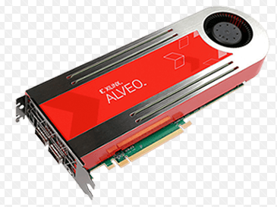
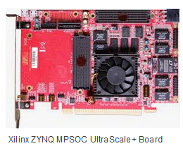
Vitis software environment /Architecture
Vitis unified software:
Vitis software: Build an application software run on hardware.
Xilinx
Vttis Libraries
OpenCV
AI/ML
Video
trans-coding
BLAS
Libraries
Compiler
Vttis development kit
Compiler
Analyzer
Debugger
Xilinx Runtime (xrt) (Interface)
PLATFORM
8
Alveo

Slide 9


Flow of Building application program on Vitis
C++ with OpenCL
HOST APPLICATION
Kernel function
C++ / RTL
gcc compiler
v++ compiler
Software build steps
Hardware build steps
Linker
v++ linker
Host application executable
.EXE
.XCLBIN
FPGA Binary .xclbin
FPGA

Slide 10

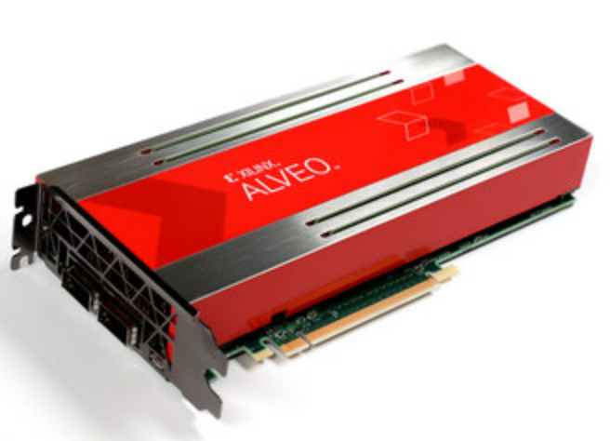
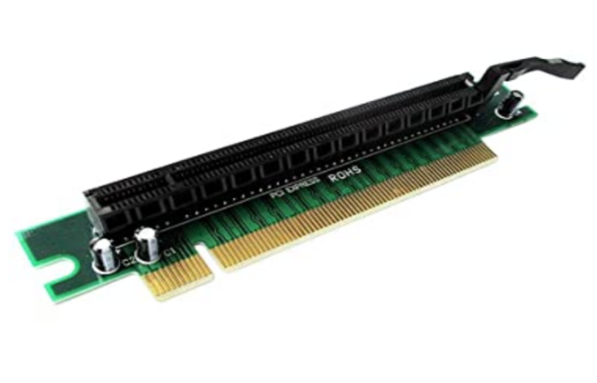
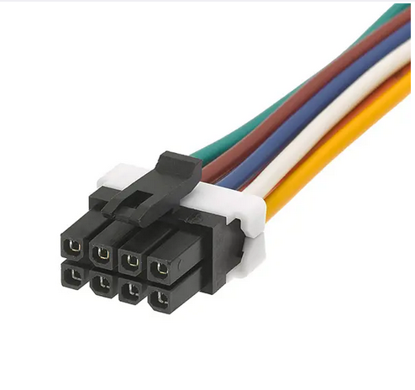
Component used to build a project
Alveo u-200 | Core i-7 2.7Ghz , 16 Go Ram
PCIe Gen 3 x 16 | Power supply (225 W)

Slide 11

FPGA USED
ALVEO CARD U200
Introduced by Xilinx
Open source
Environment : Vitis unified software
Why :
Prototype
Using multiple languages and Libraries, designers can benefits of programmable logic and CPU
High frame rate video
Low latency

Slide 12

SYSTEM ARCHITECTURE
APPLICATION PROGRAM
KERNEL
PCIe
HOST
GLOBAL MEMORY (ACCESSIBLE FOR BOTH HOST AND KERNEL)
12
HOST
FPGA

Slide 13

Programming languages
User Application of Vitis software
Host Kernel
C++/C-OPenCL
C++/C
RTL

Slide 14
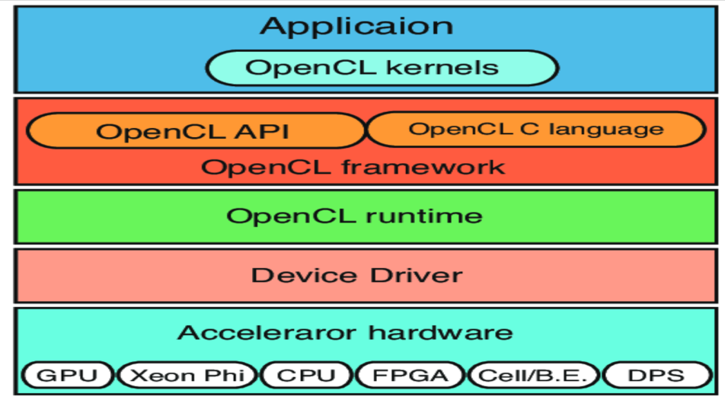
OpenCL (Host language)
OpenCL : language used to target Hardware (FPGA/ GPU / CPU, ...)
Command used on kernel program :
set up the kernel
Write/ Read data to/from Global memory
Execute data , ...

Slide 15
Library - Vitis vision
computer vision library designed to work on Vitis software .
Open source library
Small architecture
Easy and fast vs Open-CV
Available for academic and business purpose for free

Slide 16
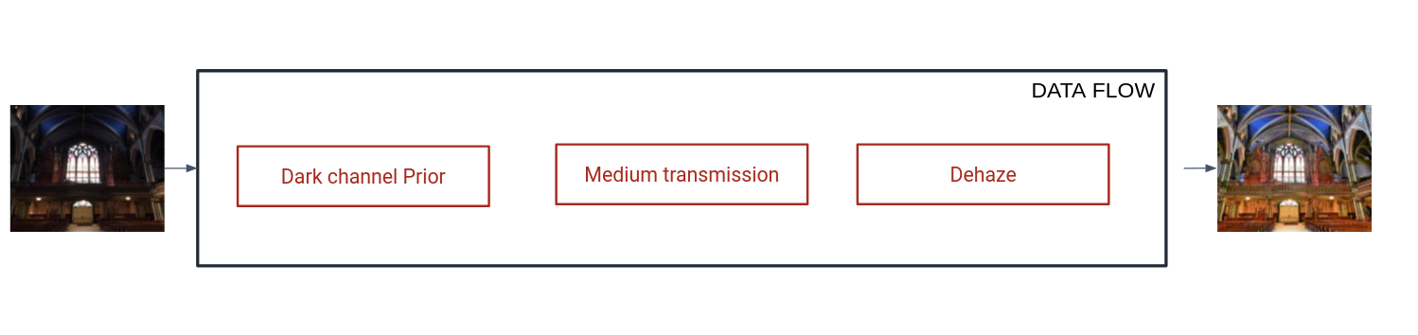
DATA FLOW OF PROPOSED ALGORITHM

Slide 17
Global architecture of proposed method
Host
Input frame
Output frame
Global Memory
Input frame
Output frame
RECOVER
AXI Interface
Vitis vision
PCIe
Kernel
DARK CHANNEL
MEDIUM TRANSMISSION

Slide 18
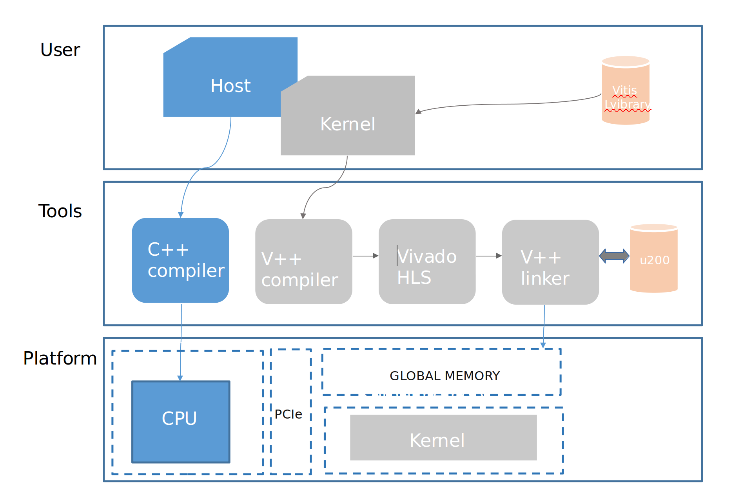
Design flow of proposed method

Slide 19
Host kernel data flow
HOST
INPUT FRAME R,G,B
OUTPUT FRAME RGB
GLOBAL MEMORY
KERNEL
9 X 9
9 X 9
9 X9
COMPUTE UNIT
Dark channel
9 X 9
Medium transmission
Dehaze
9 X 9
9 X 9

Slide 20
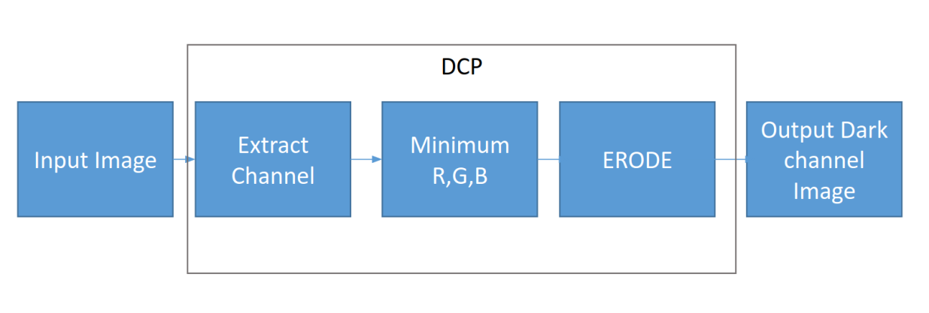
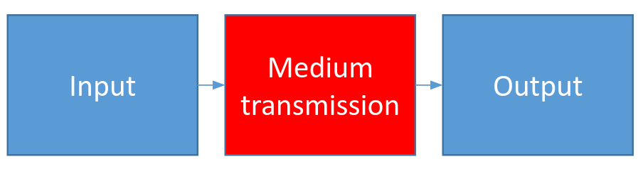
DCP / Medium transmission on Kernel
DCP and Medium transmission function is accelerated on hardware
DCP
(Vitis vision)
Medium transmission

Slide 21
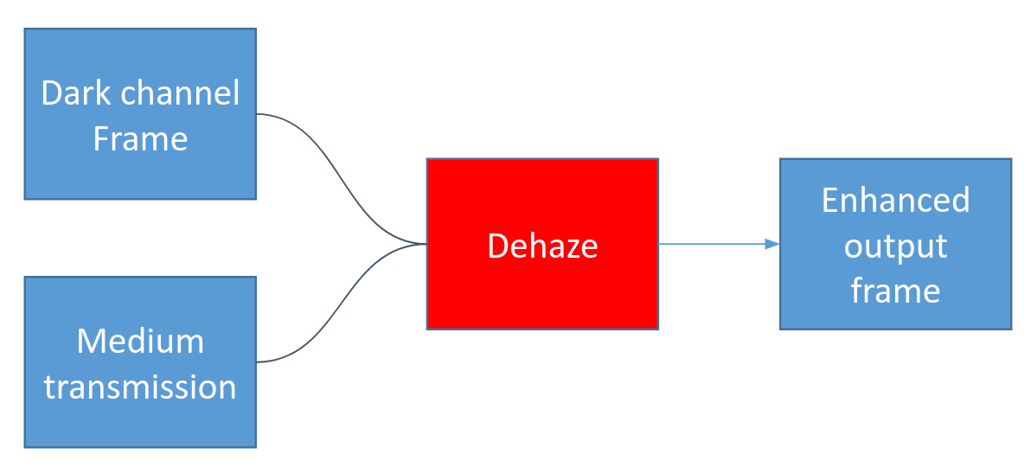
Dehaze on CPU
Recover frame : executed on software
Recover

Slide 22
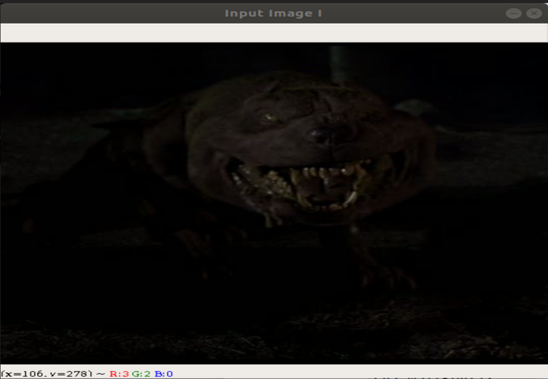
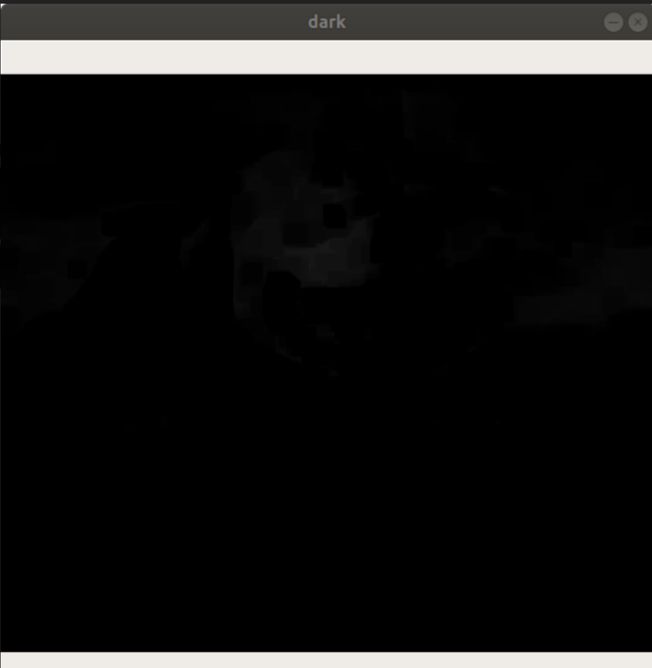
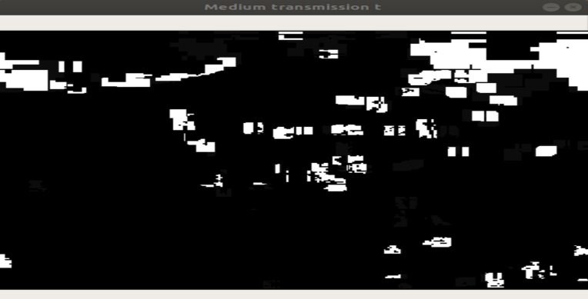
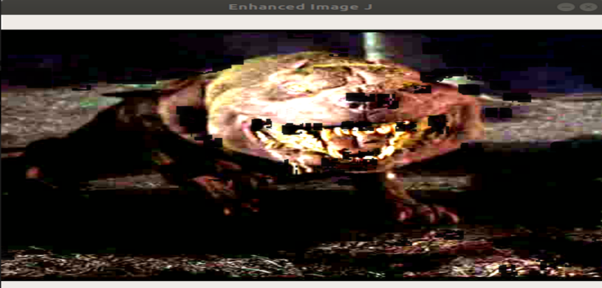
Output
Input frame | Dark input frame
 | Enhanced frame
Medium transmission

Slide 23
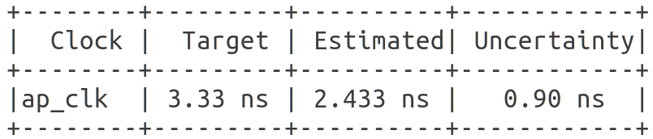
Timing summary of ap_clk

Slide 24
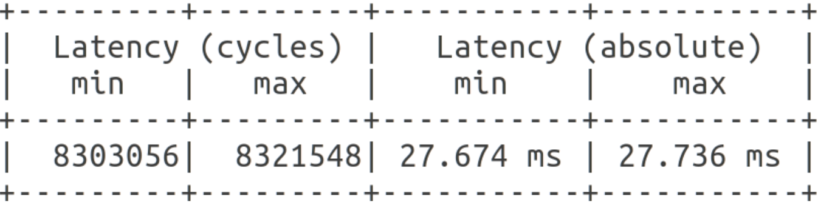
Latency

Slide 25
DCP / Medium transmission/Dehaze
Processing time on software
Frame size | DCP | Medium transmission | Dehaze
1600 x 900 | 15.58 s | 15.47 s | 0.144s
1600 x 900 | 5.23s | 5.49 s | 0.09s
1200 x 675 | 0.43s | 0.44 s | 0.02s
320 x 180 | 0.05s | 0.045s | 0.06s
DCP and Medium transmission: consume much time
Solution : create kernel for DCP and Medium transmission

Slide 26
Comparison of software/Hardware Processing time
Frame size | CPU (second) | Alveo board (msecond) Average running speed
1600 x 900 | 31.048 | 4.86
1200 x 675 | 10.71 | 2.76
640 x 360 | 0.865 | 0.81
320 x 180 | 0.087 | 0.23
Hardware : 620 faster than software with frame size (1600 x 900 )
Conclusion : Efficient

Slide 27
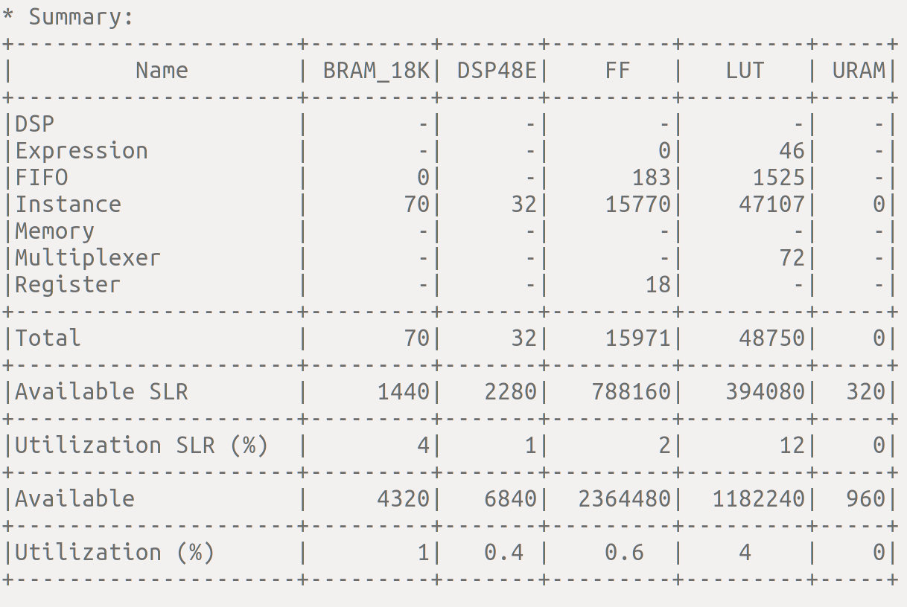
Resources used
The algorithm consume :1 % BRAM, 0.4 % DSP48E , 0.6% FF , 4% LUT
Conclusion : Efficient consume less hardware resources.

Slide 28
Conclusion
Processing time of DCP on CPU: Not sufficient
Required an hardware to accelerate DCP Algorithm.
The DCP algorithm: used less 4 % of resources on hardware.
Proposed algorithm efficient on hardware.
Future work : Increased Compute unit on hardware.

Slide 29
Reference
Author | Citation | IEEE Paper/ Journal | Year of Publish | Key Learning
Kim, M., Park, D., Han, D. K., & Ko, H | Novel framework for extremely low-light video enhancement | IEEE | 2014 | Enhancement of low light video Algorithm
Bhagya H.K Keshaveni N | Video Enhancement using Histogram Equalization with JND Mode | IJRTE | 2019 | Enhanced image with histogram equalization

Slide 30
Reference
Author | Citation | IEEE Paper/ Journal | Year of Publish | Key Learning
Z. Rahman, D. J. Jobson, and G | Multi Scale Retinex for Color Image Enhancement, | IEEE | 1996 | How to use retinex for enhancement of color image
Xuesong Jiang, Hongxun Yao, Shengping Zhang | Night video enhancement using improved Dark Channel Prior | IEEE | 2013 | How to implement enhancement of night time using DCP on software

Slide 31
Reference
Author | Citation | IEEE Paper/ Journal | Year of Publish | Key Learning
Zhu Q, Mai J, Shao L A | fast single image haze removal algorithm using color attenuation prior | IEEE | 2015 | How to use hze removal algorithm using color attenuation prior

Slide 32
Paper publication
1.SURVEY ON HARDWARE IMPLEMENTATION OF ARTIFICIAL NEURAL
NETWORK USING FIELD PROGRAMMABLE GATE ARRAY
Journal | International Journal of Research and Analytical Reviews (IJRAR)
Manuscript ID | Paper ID : 212763
Manuscript types | Review Paper
Date Submitted by the Author: | December 2019
Complete List of Authors: | Rakotojaona Nambinina, Haresh Suthar
Key word: | FPGA, neural network, activation function, look up table,piece wise linear approximation

Slide 33
Paper publication
1.ENHANCEMENT OF NIGHT TIME VIDEO USING DARK CHANNEL PRIOR IP ACCELERATOR
Journal | International Journal of Engineering and Advanced Technology (IJEAT)
Manuscript ID | Paper ID: D6707049420
Manuscript types | Research Paper
Date Submitted by the Author: | 04 march 2020
Complete List of Authors: | Rakotojaona Nambinina, Haresh Suthar, Yogesh Parmar, Carlos Valderrama
Key word: | Image enhancement, DCP, FPGA, Vitis Xilinx software

Slide 34
Github Reference
1. https://github.com/nambhine1/Vitis-software-
2. https://github.com/Xilinx/Vitis_Libraries/tree/master/vision
3. https://github.com/nambhine1/DCP_

Slide 35
Questions?

Slide 36
Thank You

